Slide 1


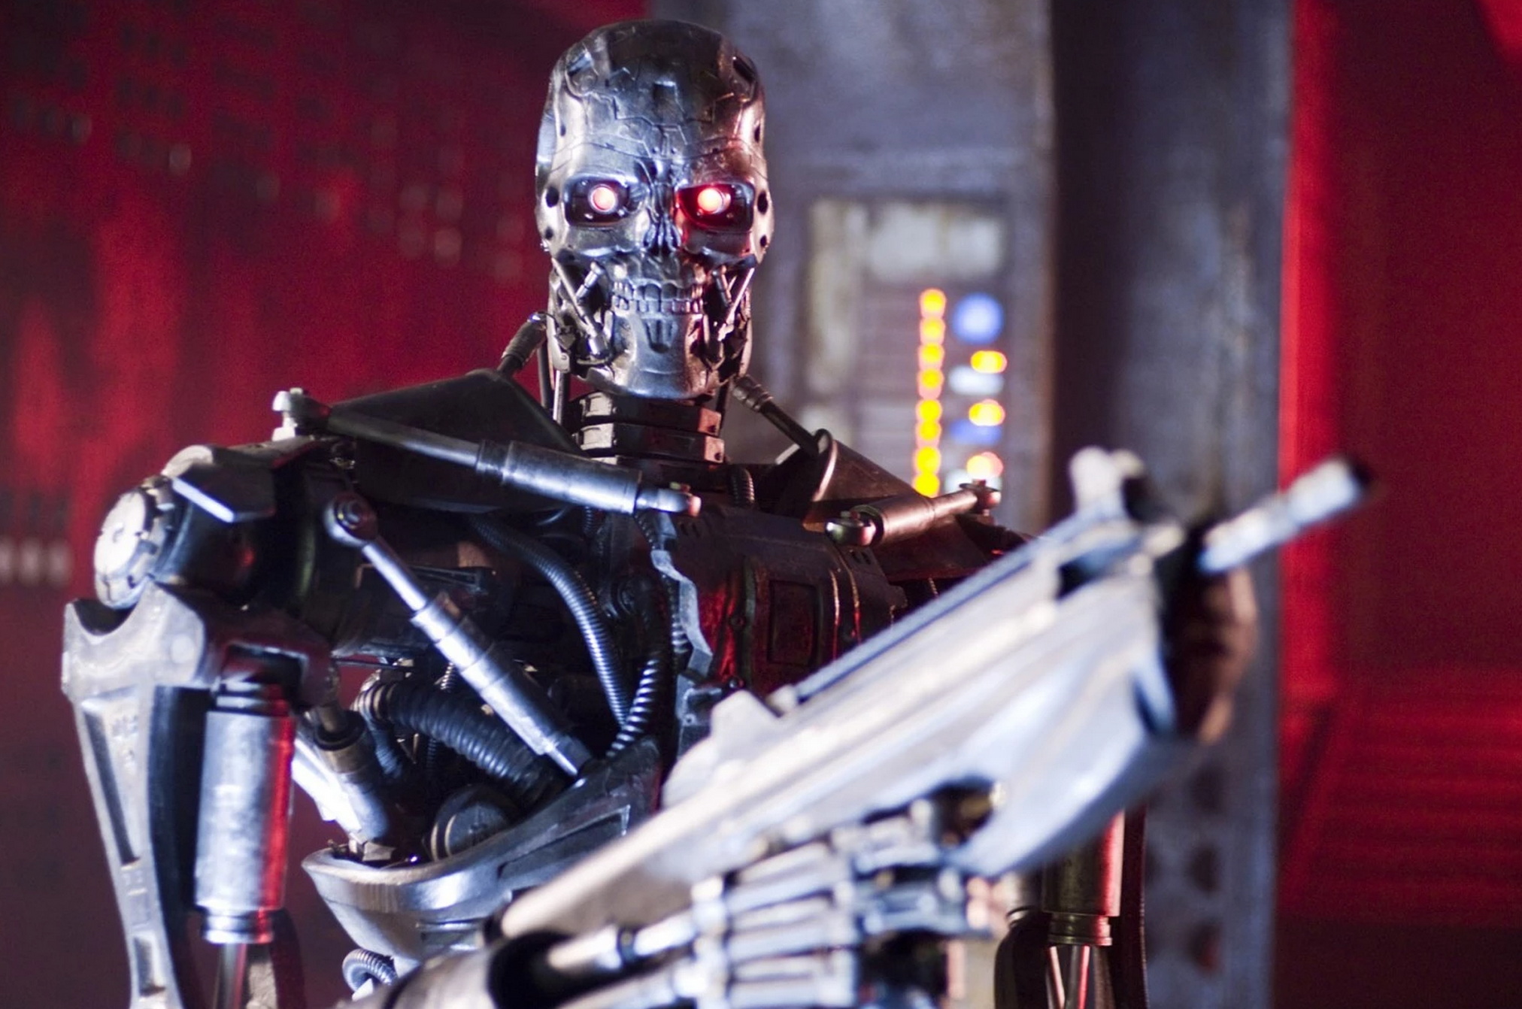
Your AI isn’t going to rise up & kill you!
UC Berkeley EECS Sr Lecturer SOE Dan Garcia
The Beauty and Joy of Computing Lecture #7 Algorithms II
IBM AI researcher says the fear of conscious AI rising up and harming us is overblown, citing: (1) intelligence – say beating us in chess – is not consciousness and we’re many many years from that, (2) “our AI are likely to derive its root volition from us”, – your self-driving car, when not giving suggestions of where to charge it and get coffee, will sit in the garage, quietly charging.
http://www.washingtonpost.com/opinions/the-robots-are-not-going-to-kill-you/2015/02/06/550e0c6e-ae10-11e4-9c91-e9d2f9fde644_story.html

Slide 2
Algorithms: Specifications

Slide 3


(AP) Computer Science Principles
7 Big Ideas
Creativity
Abstraction
Data and Information
Algorithms
Programming
The Internet
Global Impact

Slide 4
Functional Abstraction (review)
A block, or function has inputs & outputs
Possibly no inputs
Possibly no outputs (if block is a command)
In this case, it would have a “side effect”, i.e., what it does (e.g., move a robot)
The contract describing what block does is called a specification or spec
x
F
F(x)

Slide 5

What is IN a spec? (review)
Typically they all have
NAME
INPUT(s)
(and types, if appropriate)
Requirements
OUTPUT
Can write “none”
(SIDE-EFFECTS)
EXAMPLE CALLS
Example
NAME : Double
INPUT : n (a number)
OUTPUT: Twice input
SAMPLE:
x
F
F(x)

Slide 6

What is NOT in a spec?
How!
That’s the beauty of a functional abstraction; it doesn’t say how it will do its job.
Example: Double(n)
Could be n * 2
Could be n + n
Could be n+1 (n times)
if n is a positive integer
This gives great freedom to author!
You choose Algorithm(s)!
☑

Slide 7
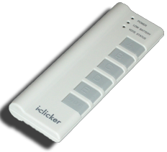
(Cal) What do YOU think?
Which factor below is the most important in choosing the algorithm to use?
Simplest?
Easiest to implement?
Takes less time?
Uses up less space (memory)?
Gives a more precise answer?

Slide 8
Algorithm Analysis

Slide 9

Algorithm Analysis: Running Time
One commonly used criterion in algorithm analysis is running time
how long does the algorithm take to run and finish its task?
How do we measure it?
08:23:12

Slide 10
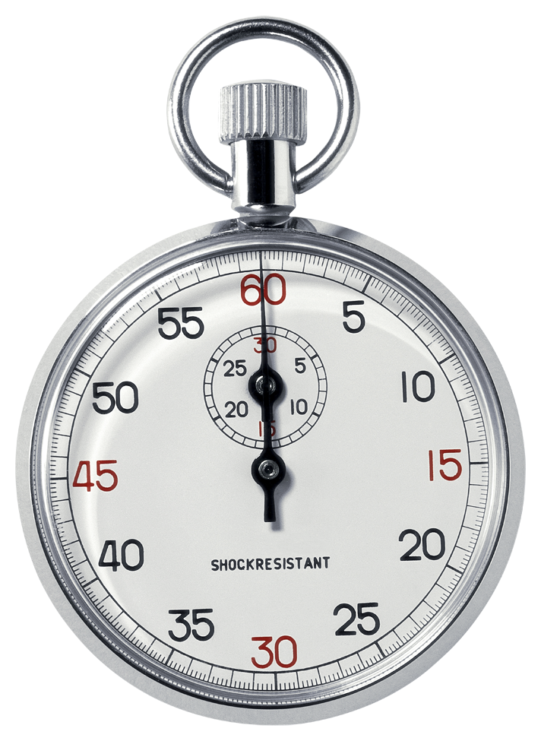
Runtime Analysis: Problem and Solution
Time w/stopwatch, but…
Different computers may have different runtimes. ☹
Same computer may have different runtimes on same input. ☹
Need to implement the algorithm first to run it. ☹
That’s called empirical analysis
Solution: Count the #of “steps” involved, not time!
Each operation = 1 step
If we say “running time”, we’ll mean # of steps, not time!

Slide 11
Runtime Analysis: Input Size & Efficiency
Given # of input things
E.g., # of list elements
E.g., # of sentence characters
We define efficiency as a function of the input size
Running time (# of steps)
Memory Usage
We determine efficiency by reasoning formally or mathematically
Important!
In BJC we won’t care about the efficiency of your solutions!
Usually they care in CS2

Slide 12
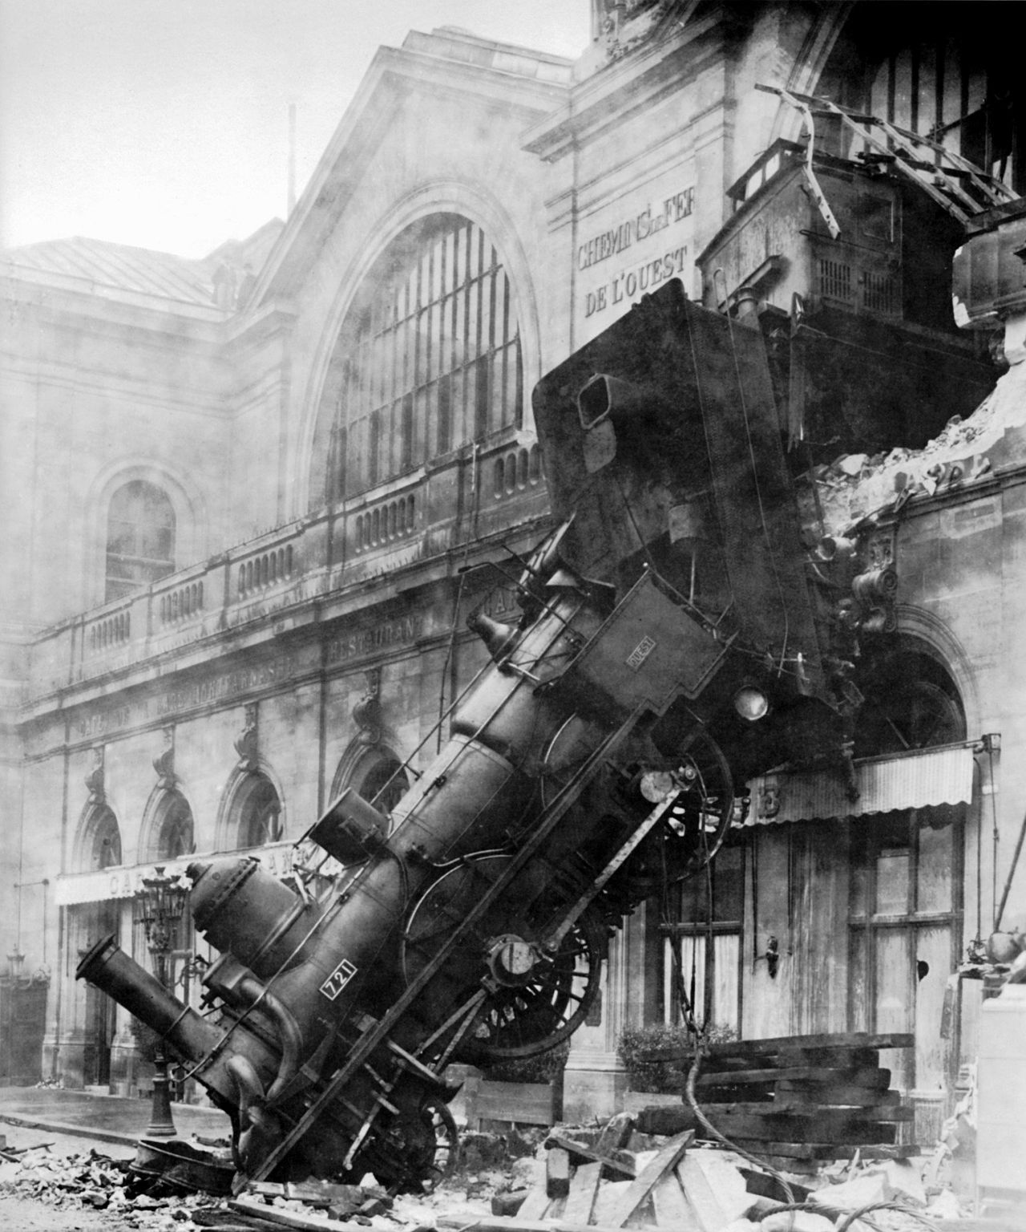
Runtime Analysis: Worst or Avg Case?
Could use avg case
Average running time over a vast # of inputs
Instead: use worst case
Consider running time as input grows
Why?
Nice to know most time we’d ever spend
Worst case happens often
Avg is often ~ worst
Montparnasse Derailment (Wikipedia, Public Domain)

Slide 13
Runtime Analysis: Order of Growth
Instead of an exact number of operations we’ll use abstraction!
Want order of growth, or dominant term
In BJC we’ll consider
Constant
Logarithmic
Linear
Quadratic
Cubic
Exponential
E.g. 10 n² + 4 log n + n
…is quadratic
More efficient algorithm
Could be more complex…
But helps handle larger input!
Exponential
Cubic
Quadratic
Linear
Logarithmic
Constant
Graph of order of growth curves on log-log plot
☑

Slide 14

(Cal) Example: Finding a student (by ID)
Input
Unsorted list of students L
Particular student S
Output
True if S is in L, else False
Pseudocode Algorithm
Go through one by one, checking for match.
If match, true
If exhausted L and didn’t find S, false
Worst-case running time as function of the size of L?
Constant
Logarithmic
Linear
Quadratic
Exponential

Slide 15
(Cal) Example: Finding a student (by ID)
Input
Sorted list of students L
Particular student S
Output : same
Pseudocode Algorithm
Start in middle
If match, report true
If exhausted, throw away half of L and check again in the middle of remaining part of L
If nobody left, report false
Worst-case running time as function of the size of L?
Constant
Logarithmic
Linear
Quadratic
Exponential

Slide 16
(Cal) Example: Finding a student (by ID)
What if L were given to you in advance and you had infinite storage?
Could you do any better than logarithmic?
Worst-case running time as function of the size of L?
Constant
Logarithmic
Linear
Quadratic
Exponential

Slide 17
(Cal) Example: Finding a Shared Birthday
Input
Unsorted list L (of size n) of birthdays of team
Output
True if any two people shared birthday, else False
What’s the worst-case running time?
Worst-case running time as function of the size of L?
Constant
Logarithmic
Linear
Quadratic
Exponential

Slide 18
(Cal) Example: Finding Subsets
Input:
Unsorted list L (of size n) of people
Output
All the subsets
Worst-case running time? (as function of n)
E.g., for 3 people (a,b,c):
1 empty: { }
3 1-person: {a, b, c}
3 2-person: {ab, bc, ac}
1 3-person: {abc}
Worst-case running time as function of the size of L?
Constant
Logarithmic
Linear
Quadratic
Exponential

Slide 19
Algorithms: Correctness, Summary

Slide 20
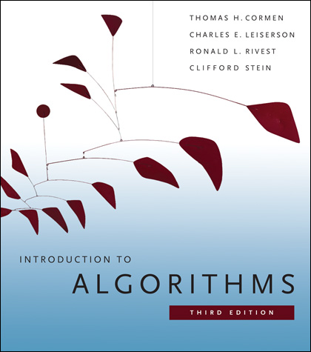
Reference Text for Algorithms
This book launched a generation of CS students into Algorithm Analysis
It’s on everyone’s shelf
It might be hard to grok at this point, but if you go on in CS, remember it & own it!
…but get the most recent vears

Slide 21
Algorithm Analysis: Is Algorithm Correct?
An algorithm is correct if, for every input, it reports the correct output and doesn’t run forever or cause an error.
Incorrect algorithms may run forever, or may crash, or may not return the correct answer.
They could still be useful!
Consider an approximation…
For now, we’ll only consider correct algorithms
Euclid’s GCD Algorithm (Wikimedia)

Slide 22
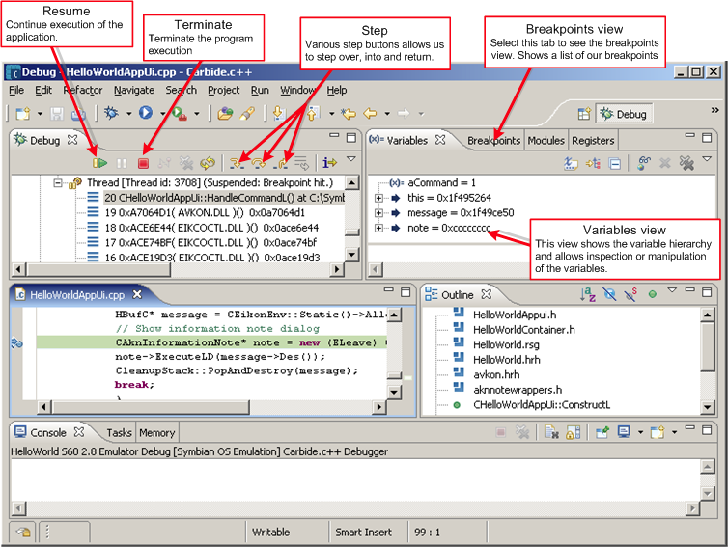
How do you know if it is correct?
For algorithms?
Reasoning formally or mathematically
For programs? Empirically via testing:
Unit Testing
Debugging
Can never be sure algorithm is correct by testing implemention

Slide 23
Summary
When developing an algorithm, could optimize for
Simplest
Easiest to implement?
Efficient? (running time, memory)
Uses up least resources
Gives most precision
…
In BJC we’ll consider
Constant
Logarithmic
Linear
Quadratic
Cubic
Exponential
Many problems can be solved in a reasonable time
Reasonable time means that as the input size grows, the number of steps the algorithm takes is proportional to the square (or cube, fourth power, fifth power, etc.) of the size of the input. (not exponential)
Different correct algorithms for the same problem can have different efficiencies.
E.g., Linear search can be used when searching for an item in any list; binary search can be used only when the list is sorted.
Some problems cannot be solved in a reasonable time, even for small input sizes.

